Slide 1
Patterning & Algebra
Grade 8 2017

Slide 3
Expression & Equations
Expressions: A number sentence without an equal sign that cannot be solved i.e) 2n+3 three more than two times a number
Equation: a mathematical statement that is equal that can be solved
i.e)2n+3 =13 therefore n =5
2(5) + 3= 13
Variable: a letter or symbol that represents an unknown value i.e) n means a number
Constant: a number on its own. i.e) 3

Slide 4
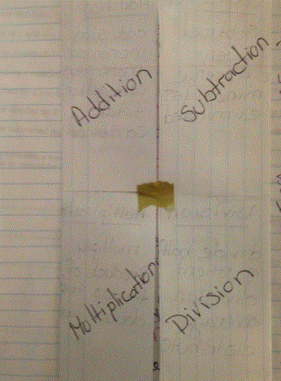
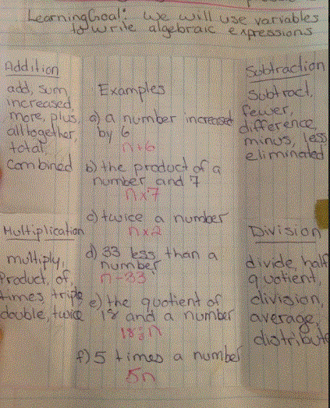

Slide 5
Expressions vs Equations
Guided PRACTICE

Slide 6
Patterns
Arithmetic Sequence
In an arithmetic sequence, there is a constant difference between consecutive terms. This means that you can always get from one term to the next by adding or subtracting the same number.
2, 4, 6, 8 Goes up +2 each time
Geometric Sequence
In a geometric sequence, there is a constant multiplier between consecutive terms. This means that you can always get from one term to the next by multiplying or dividing by the same number.
5, 10, 20, 40, Multiplied by 2 each time
IXL Practice
Class Work Pattern Sleuthing Sheet

Slide 7
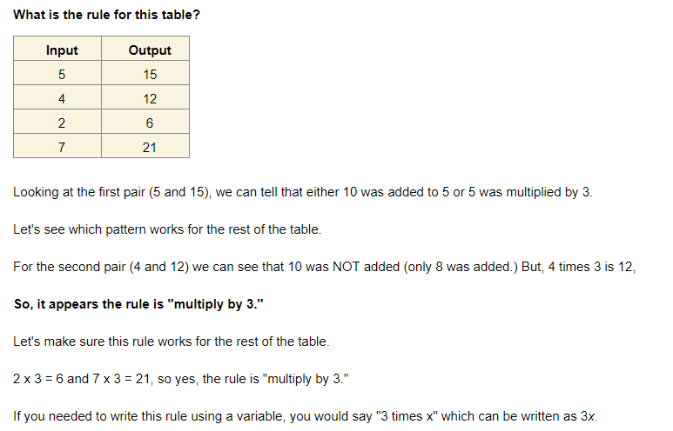
Input/Output

Slide 9
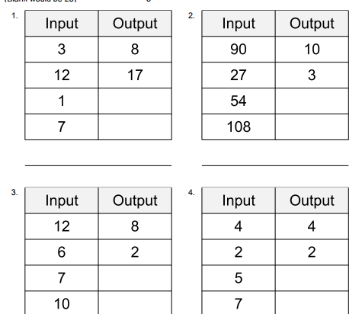
Practice
Input/output

Slide 10
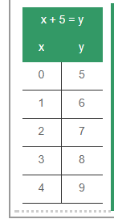
What pattern is happening here?

Slide 11
Pattern Rule: Start at 0 and add 5 to x (term #)
Algebraic Equation: x + 5 = y

Slide 12
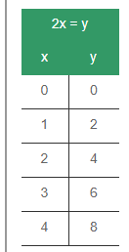
WHat is the pattern here?

Slide 13
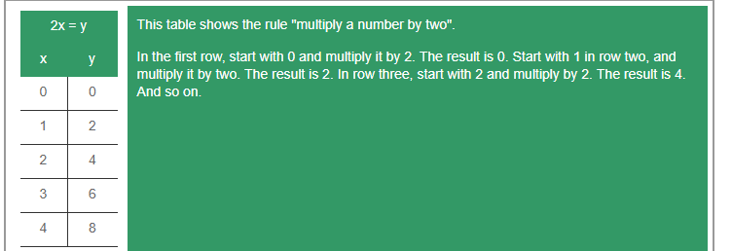
Pattern Rule: Start at 0 and multiply x by 2
Algebraic Equation: 2x= y

